Slide 1
AWS EC2 Lab - 1
Creating a VM and SSH

Slide 2
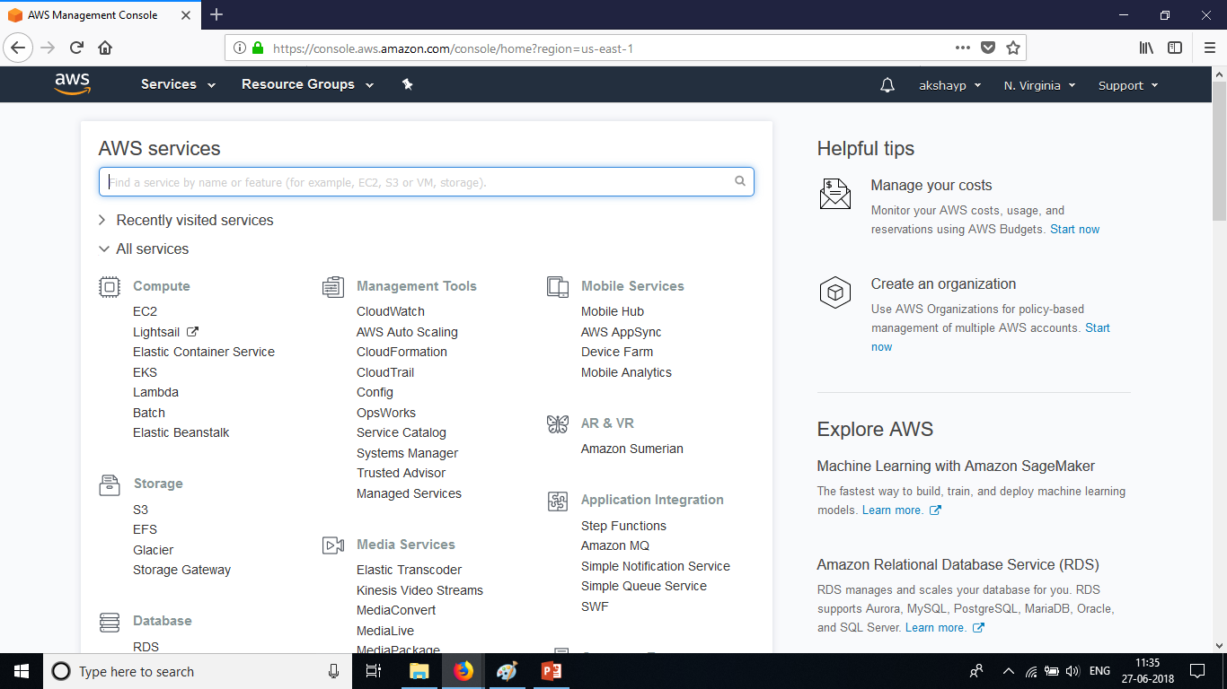
Creating a VM and SSH
Login to AWS Management Console. Click on EC2 under Services tab.

Slide 3
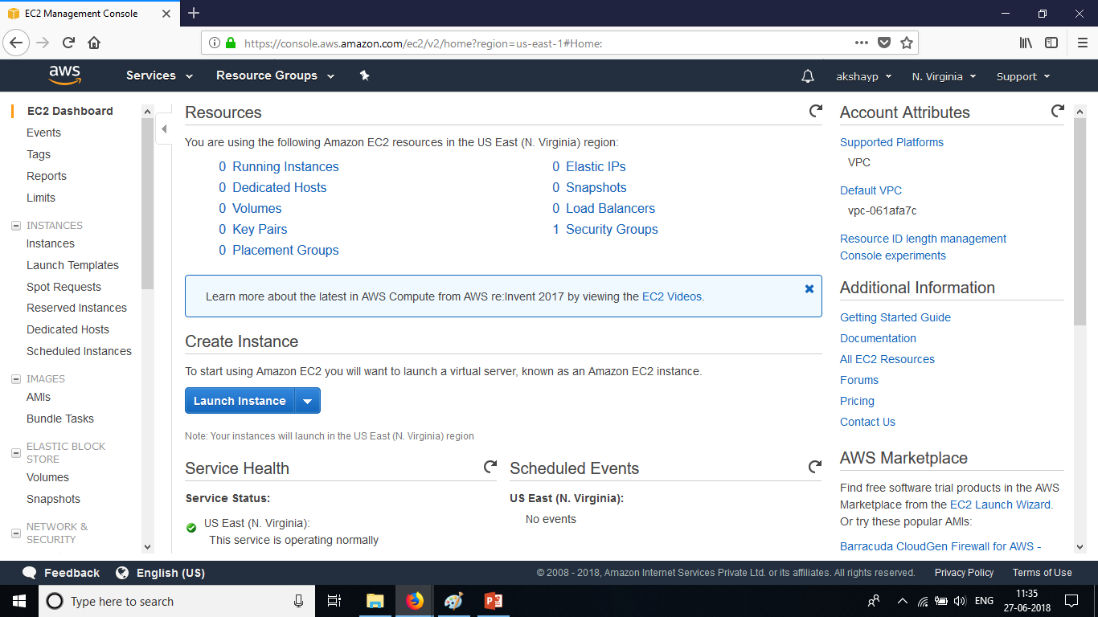
Creating a VM and SSH
This screenshot below is the landing page of EC2. Describes a lot of details. Notice the Launch Instance button. Click on it.

Slide 4
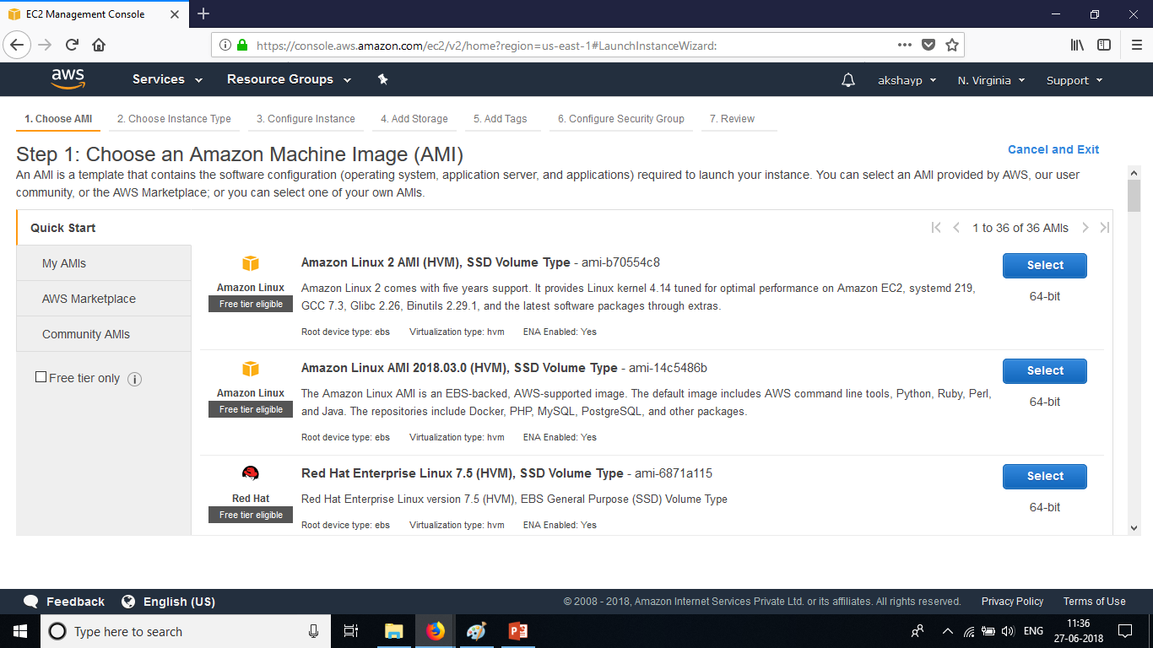
Creating a VM and SSH
Note that EC2 is a region based service whereas S3 and IAM are global services. This screenshot describes the AMI-Amazon Machine Image or the operating system along with some packages or applications that come installed.

Slide 5
Creating a VM and SSH
The screenshot also describes the virtualization type which is hardware virtualization. It also specifies the volume type that is supported which is SSD – Solid State Drive. It also describes the packages that come along with the AMI which in the case of Amazon Linux AMI, the user also gets AWS CLI, Python, Java and so on. The root device volume is EBS which stands for Elastic Block Storage where S3 was object based storage.

Slide 6
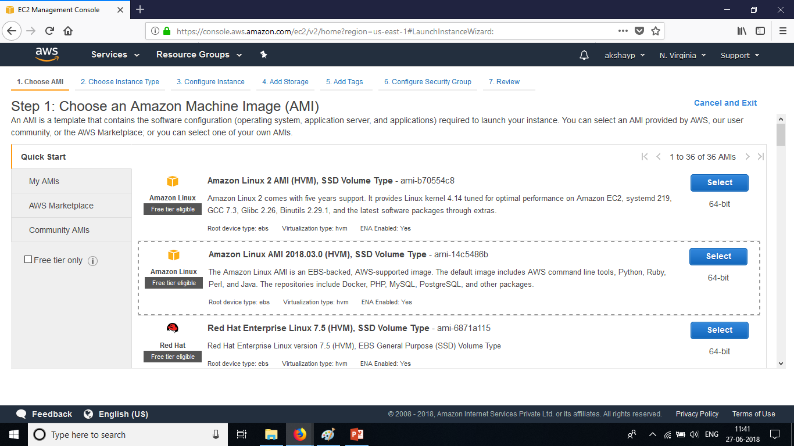
Creating a VM and SSH
Choose Amazon Linux AMI 2018.03.0 (HVM) , SSD Volume Type

Slide 7
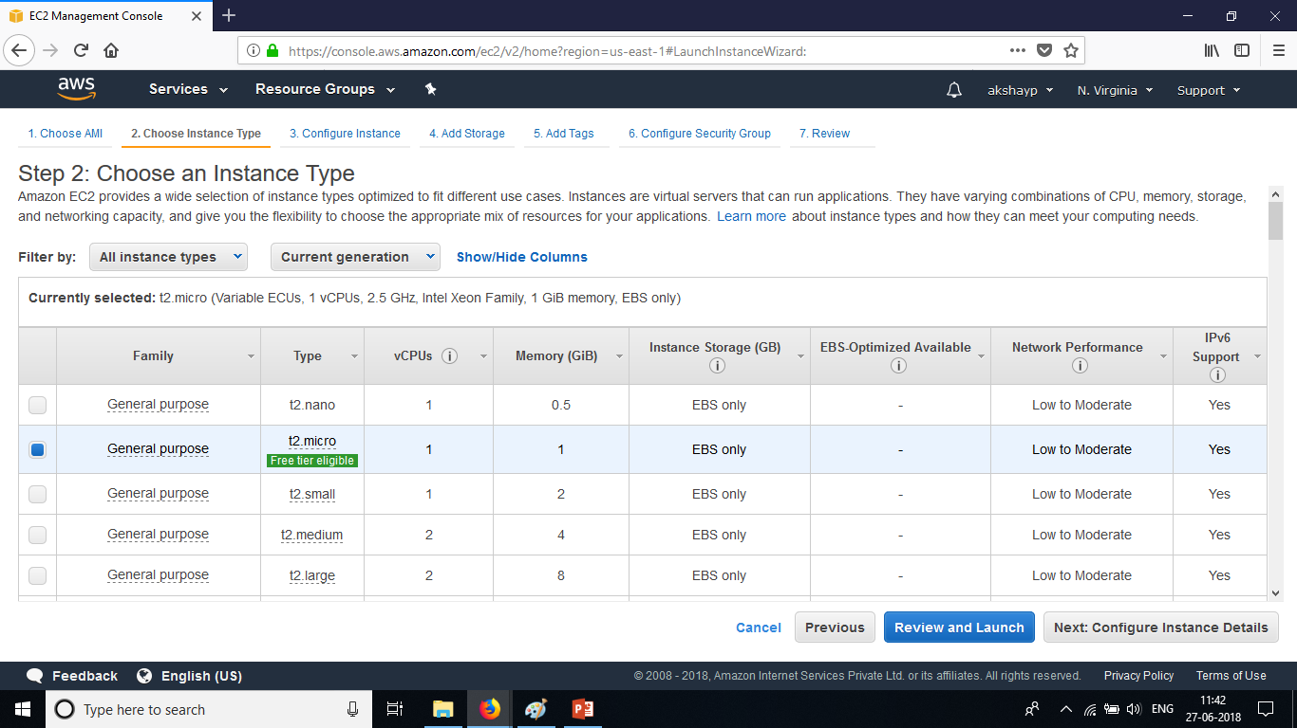
Creating a VM and SSH
Choose the instance type to be t2.micro which has 1 virtual CPU and 1 GB of RAM.

Slide 8
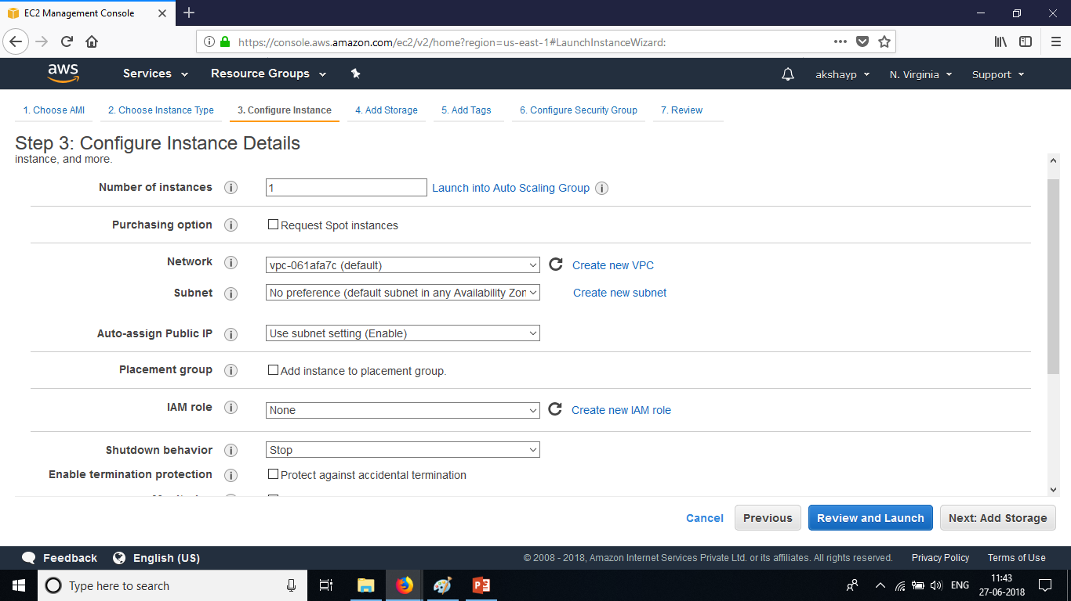
Creating a VM and SSH
The instance configuration describes the number of instances that the user wants to launch. Whether the user would like spot instances, the network configuration is the default VPC – Virtual Private Cloud. The subnet preference can be left as default and AWS would choose the subnet for that default VPC at random.

Slide 9
Creating a VM and SSH
The auto-assign public IP setting is that of the subnet and its enabled by default. Hence the user would get a public IP for the instance. The IAM role setting could be given if the user would like EC2 to do specific actions on behalf of the user. IAM role is used for one service to talk to another.

Slide 10
Creating a VM and SSH
The shutdown behaviour setting can be set to stop or terminate based on the need. Enable termination protection setting can be enabled if the user would not like anyone else to terminate the instance by mistake. Until and unless its disabled, the instance cannot be terminated.

Slide 11
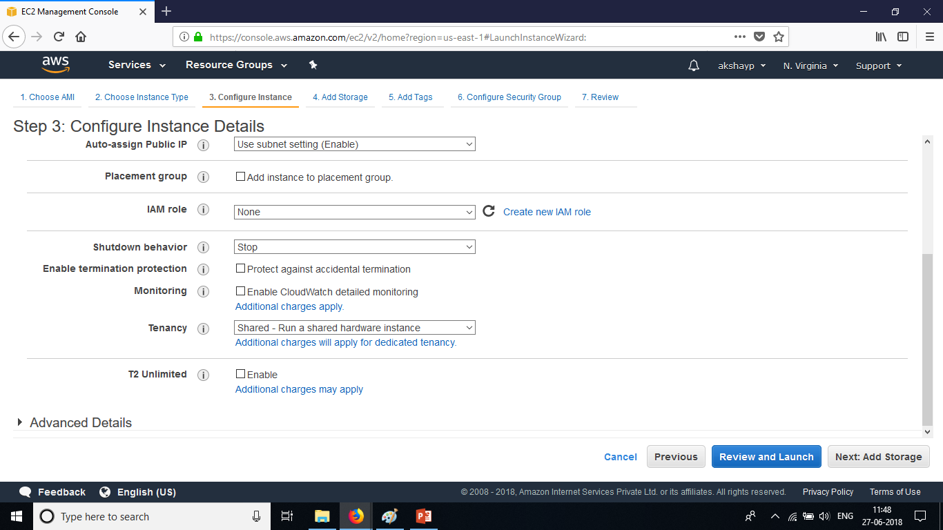
Creating a VM and SSH
The monitoring configuration can be left as default for basic monitoring which is every 5 minutes or if detailed monitoring is enabled then its set for every 1 minute and additional charges will apply. Some of the EC2 metrics monitored by CloudWatch are CPU Utilization, Disk , N/W and Status Checks.

Slide 12
Creating a VM and SSH
The tenancy configuration can be changed based on the organization’s need for having a dedicated instance or a dedicated host or if it’s a small application then shared hardware could be the default. T2 unlimited describes the burst CPU processing of the instance. For Eg from 2.5Ghz to 3.2Ghz for CPU intensive applications.

Slide 13
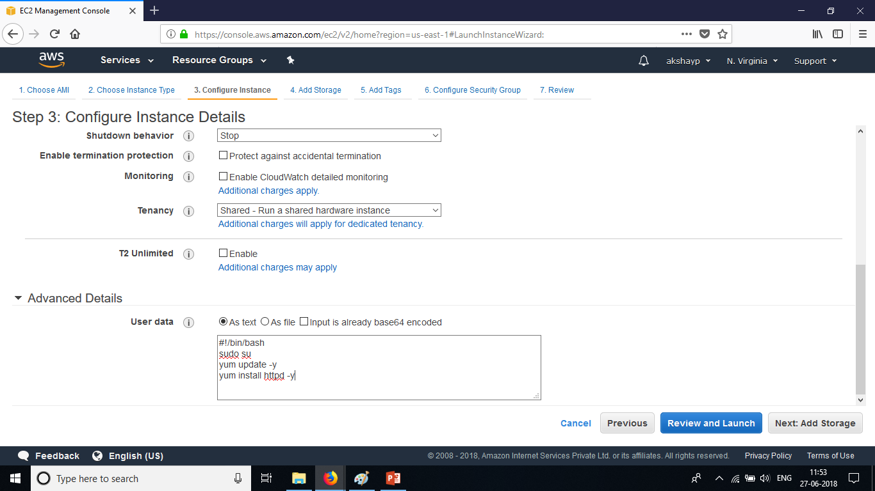
Creating a VM and SSH
Under Advanced Details – Scripts can be run when the VM starts such as installation of necessary packages, starting a service, copying files from S3.

Slide 14
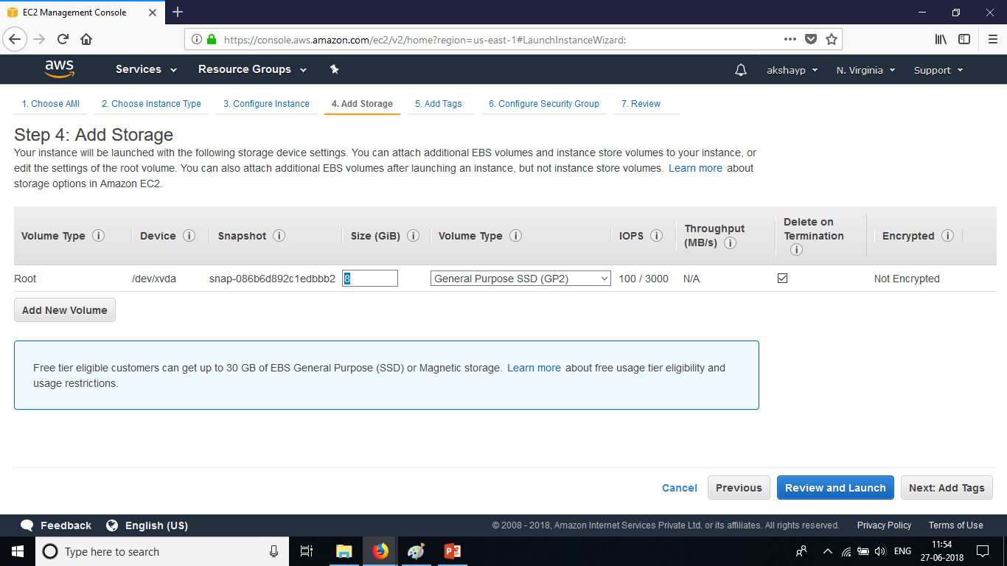
Creating a VM and SSH
Under the Add Storage tab, additional storage other than the root volume can be added for an EC2 instance which can be thought of as internal hard disk for the VM. The root volume can be of General Purpose SSD, Provisioned IOPS SSD and Magnetic Volume type only. The VM and the EBS volume both reside within the same availability zone for obvious latency reasons.

Slide 15
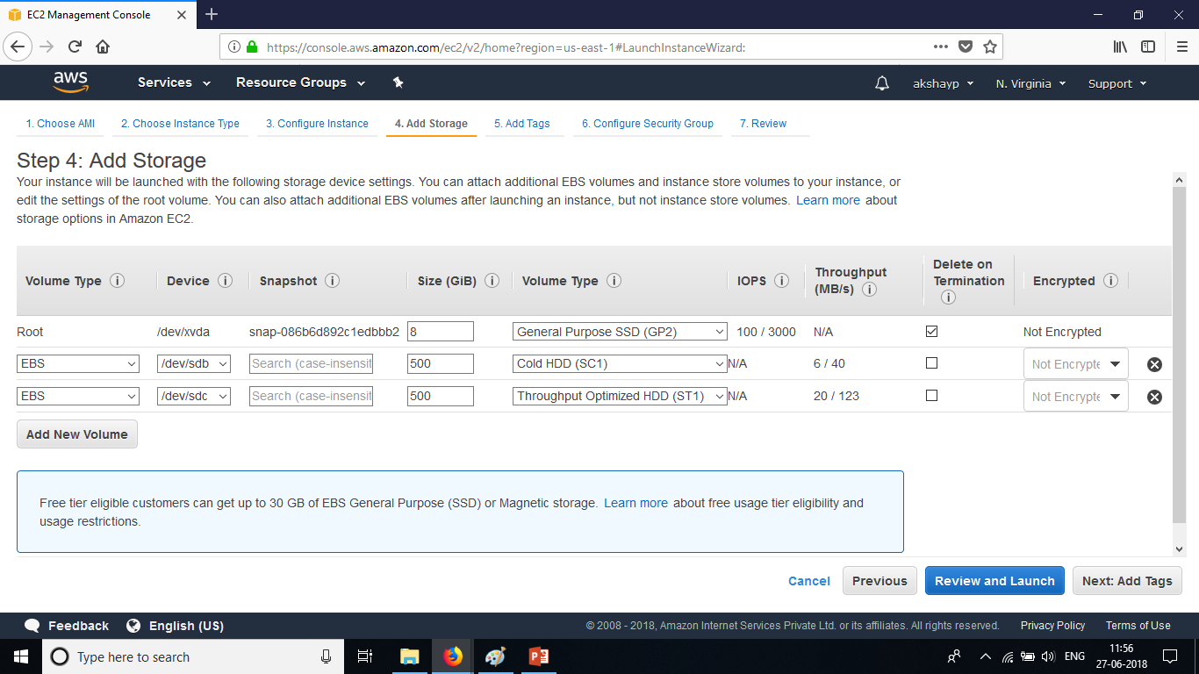
Creating a VM and SSH
Additional Volumes can be added to the VM and they can be of two other volume types which as Cold HDD and Throughput Optimized HDD and the additional volumes can be encrypted. To not to go out of free-tier access, the user can have upto 30 GB of storage collectively.

Slide 16
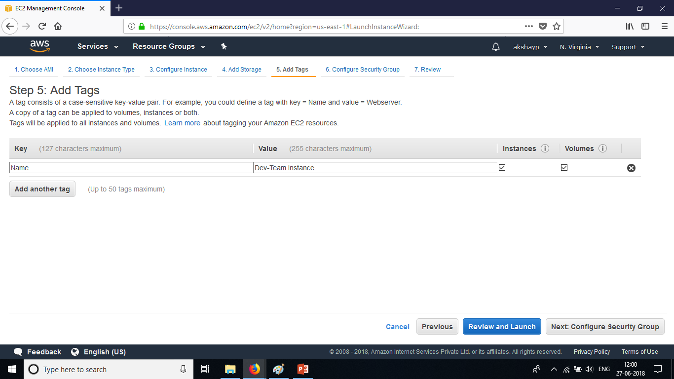
Creating a VM and SSH
In the Tags section, the user can configure a Name tag for the EC2 instance/VM so that when the organization pays the monthly bill for AWS, the system administrator can control costs by looking at which region’s EC2 instance cost more than the others. To control costs, tags are useful.

Slide 17
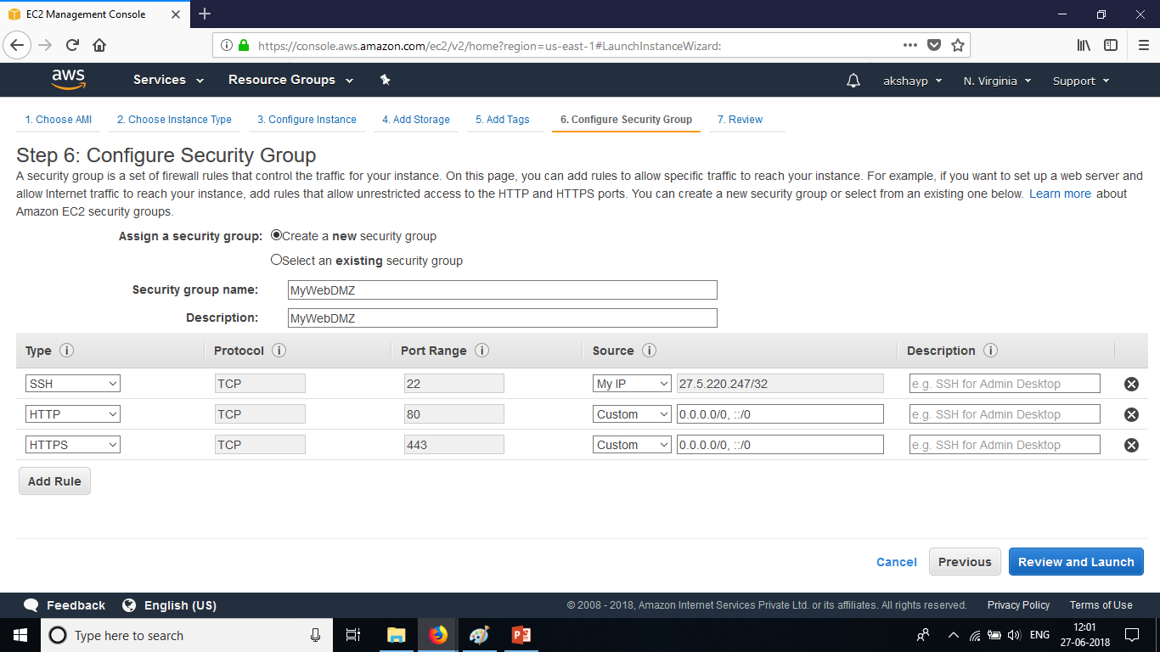
Creating a VM and SSH
Security Groups are stateful firewalls in the sense that the traffic that is allowed inbound is also allowed outbound. Security groups cannot be used to deny IP addresses but it can be used to deny/allow traffic on certain port numbers and restrict access to the port numbers with IP address in the Source tab. By default all traffic is denied. Explicit allow overrides default Deny.

Slide 18
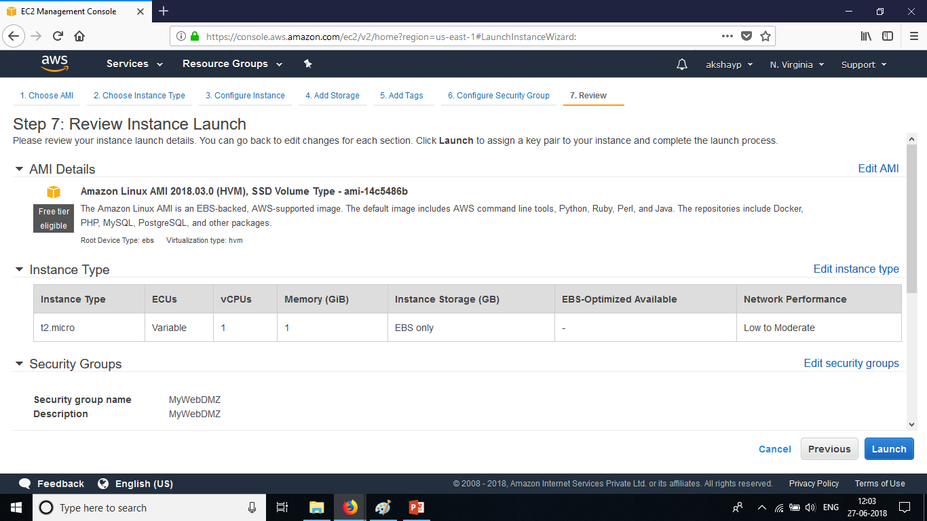
Creating a VM and SSH
Review all the settings done and click on Launch.

Slide 19
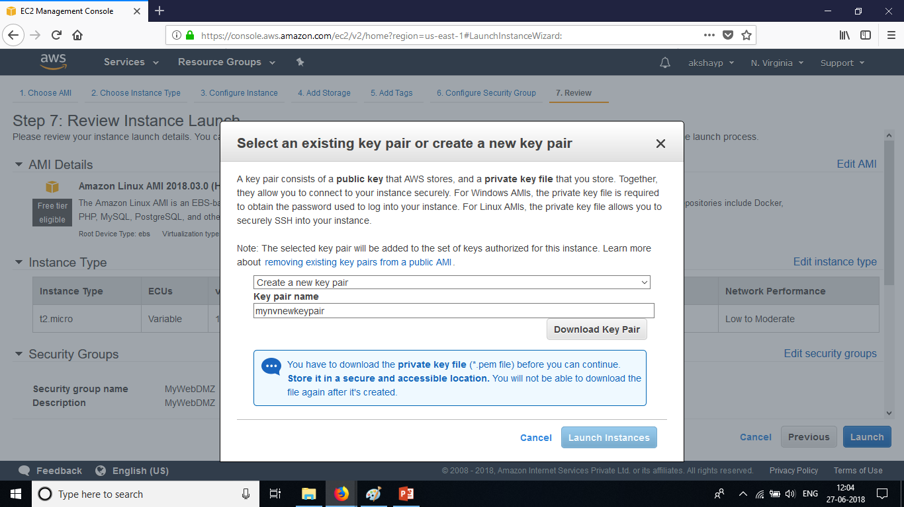
Creating a VM and SSH
Create a new key pair. A key pair is a private key and public key. Amazon maintains the public key for the EC2 instance/VM and the private key is given by the user for authentication. Save the key pair to the system’s local directory and click on Launch Instances.

Slide 20
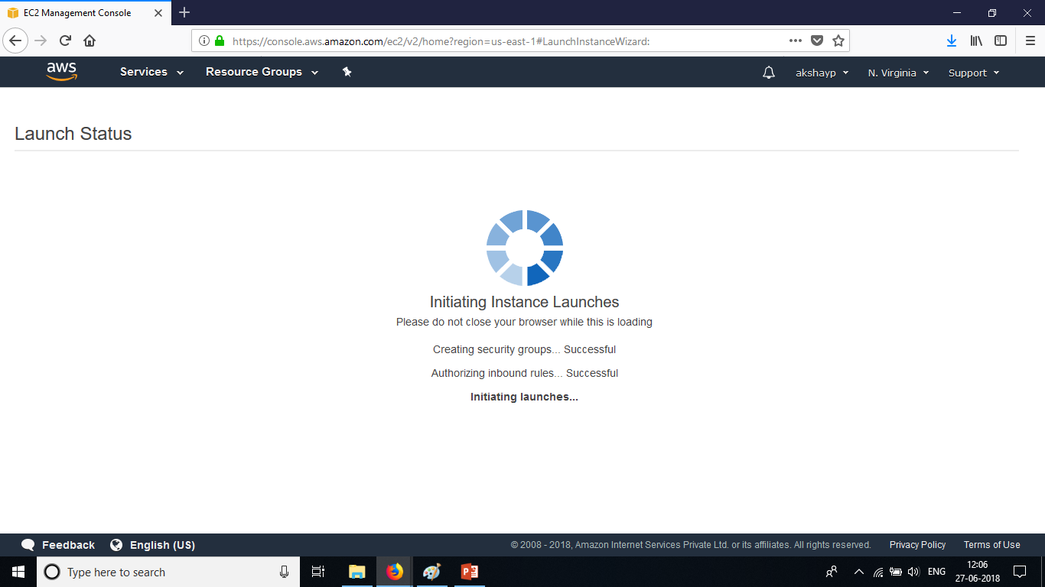
Creating a VM and SSH
Once the instance launches, Click on View Instances to view the instances that are launched and are in running state.

Slide 21
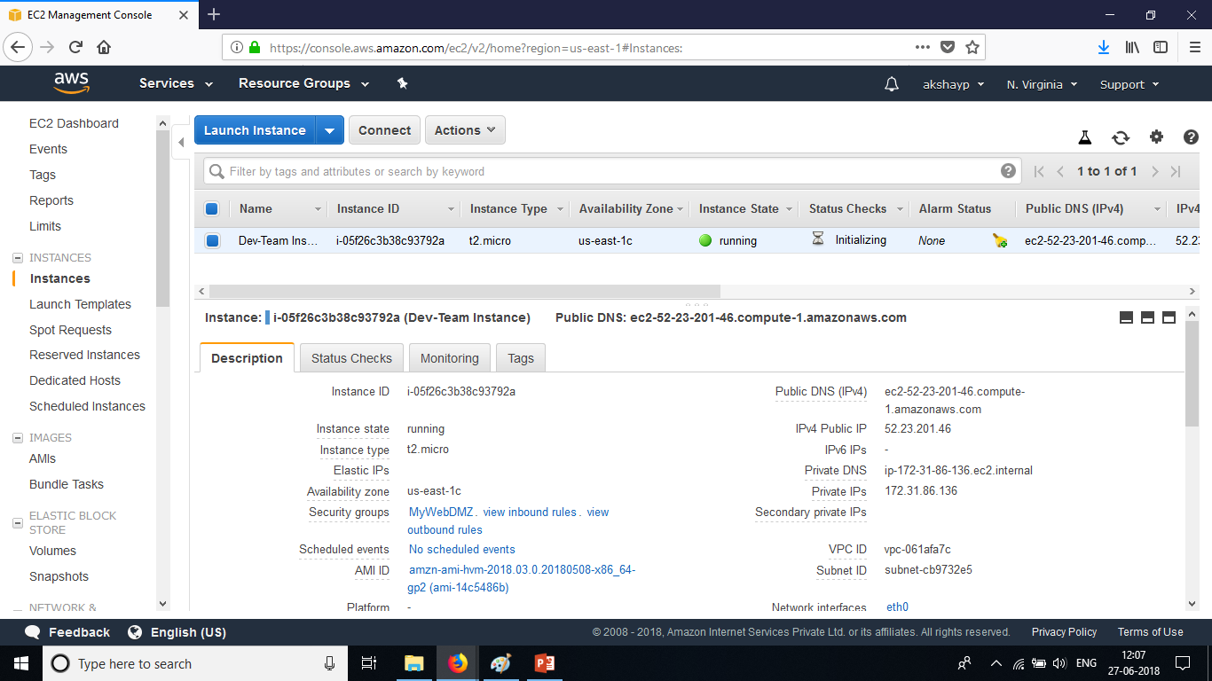
Creating a VM and SSH
The instances dashboard page opens up and all the instances that are running are displayed here. The instance lifecycle has these following stages : pending, running, shutting-down, terminated. The user can view all the details of the running instances by click on the running instance.

Slide 22
Creating a VM and SSH
The virtual machine that the user creating is now in running state and to login to the virtual machine and into the operating system , the user should use an SSH client. In the security groups page, we had configured SSH over port 22 to be only from the user’s respective IP address. Therefore only the user will be able to login to the operating system of the instance.
If running a host operating system of windows :
Install Putty and PuttyGen where Putty is used as an SSH client and PuttyGen is used to convert the .pem file to a .ppk file for windows.
Download Putty :
https://www.putty.org/
If running a host operating system of Linux :
Not necessary to install any SSH client. By default openssh is present with Linux operating system. Open up terminal and type the following command with the proper syntax listed below.
Syntax : ssh ec2-user@<Public IPV4> -i <KeyFile>
Note : Windows users follow the next few slides to SSH into the operating system of the VM.

Slide 23
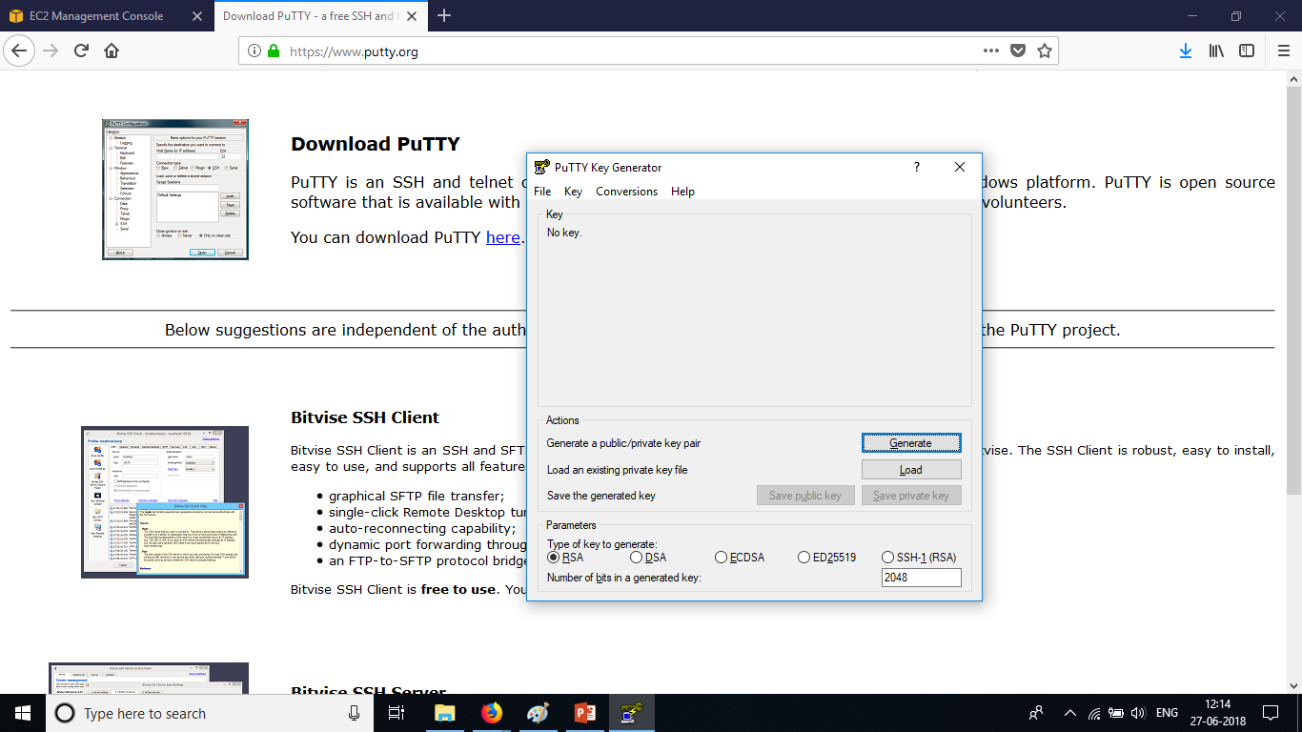
Creating a VM and SSH
Launch PuttyGen, Click on Load. Choose All files and then choose the key pair that was downloaded from the AWS Management Console. Click on OK.

Slide 24
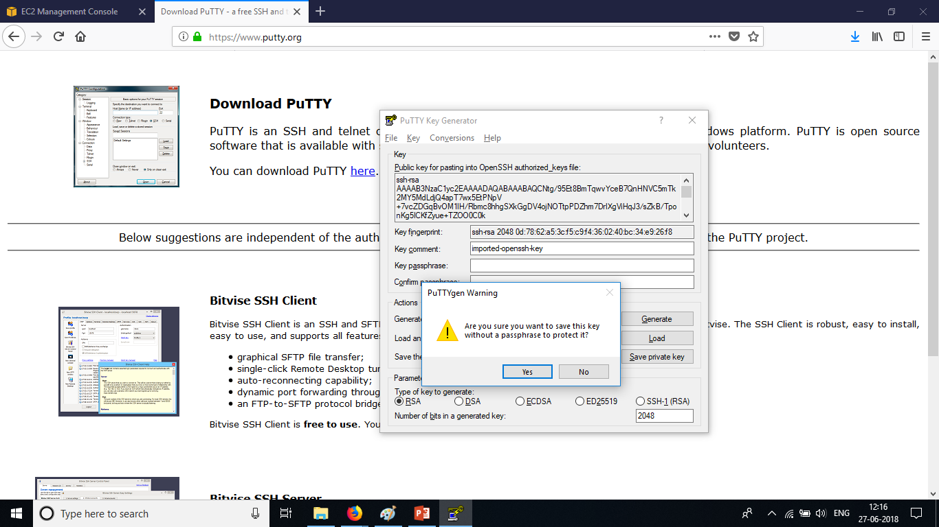
Creating a VM and SSH
Click on Save Private Key. Give it a passphrase or leave as default. Click Yes. Save the private key as a .ppk file on your local system.

Slide 25
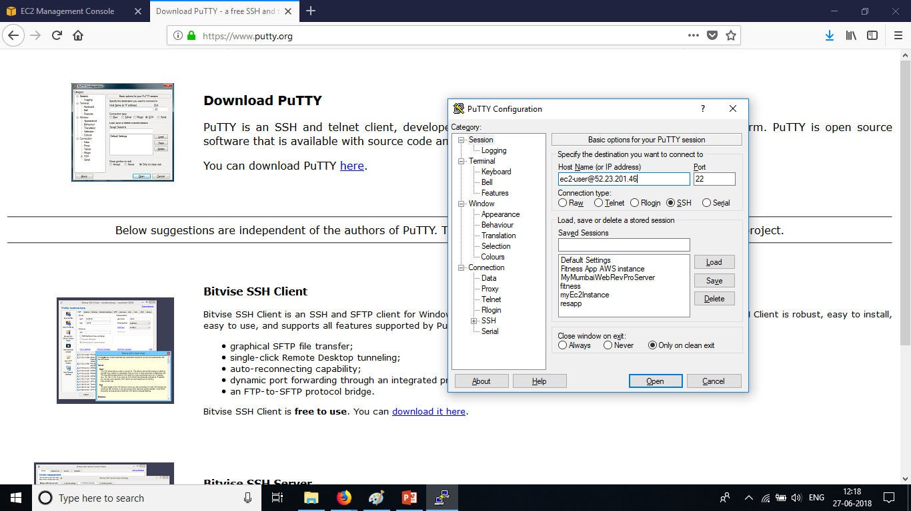
Creating a VM and SSH
Once the private key is saved as a .ppk file. Launch Putty and under the Host Name type ec2-user@<Public IP>. Choose SSH. Choose Auth and load the private key saved on the local system.

Slide 26
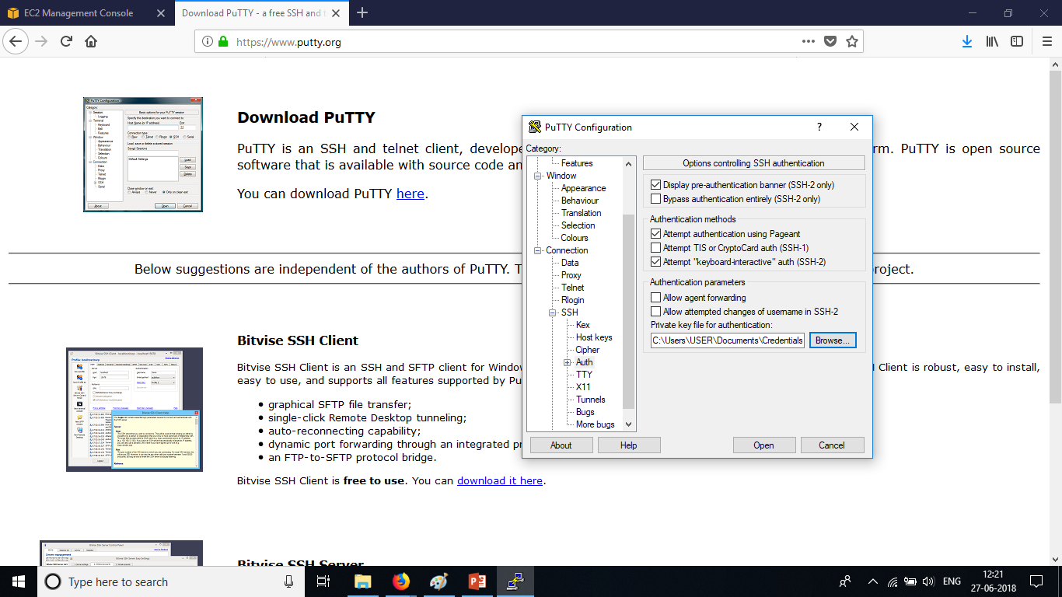
Creating a VM and SSH
Choose SSH. Choose Auth and load the private key from the local system where it is saved as .ppk file and then Click Open.

Slide 27
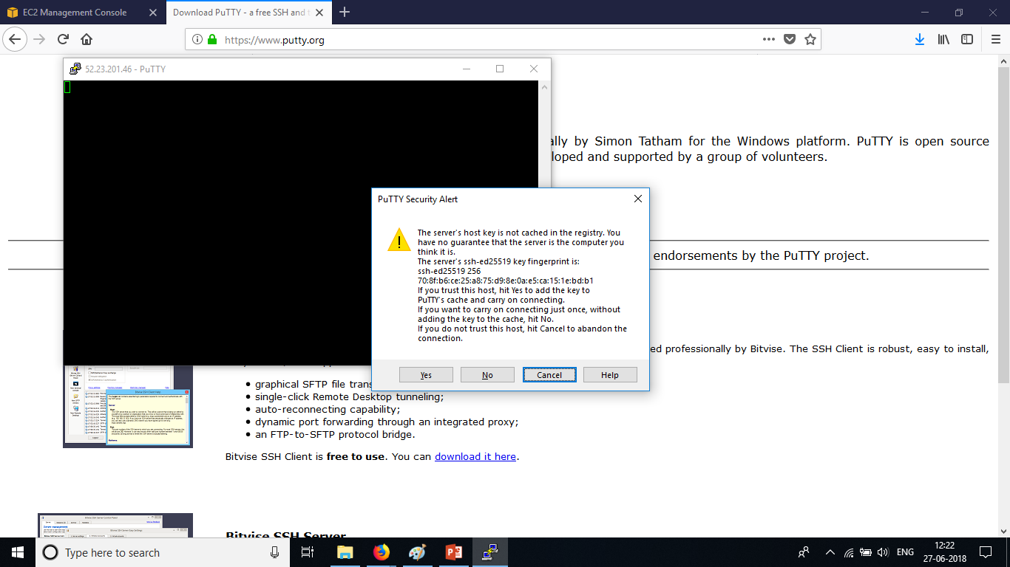
Creating a VM and SSH
A security alert is displayed. Ignore the warning message and Click on Yes. Now the user is into the operating system of the VM.

Slide 28
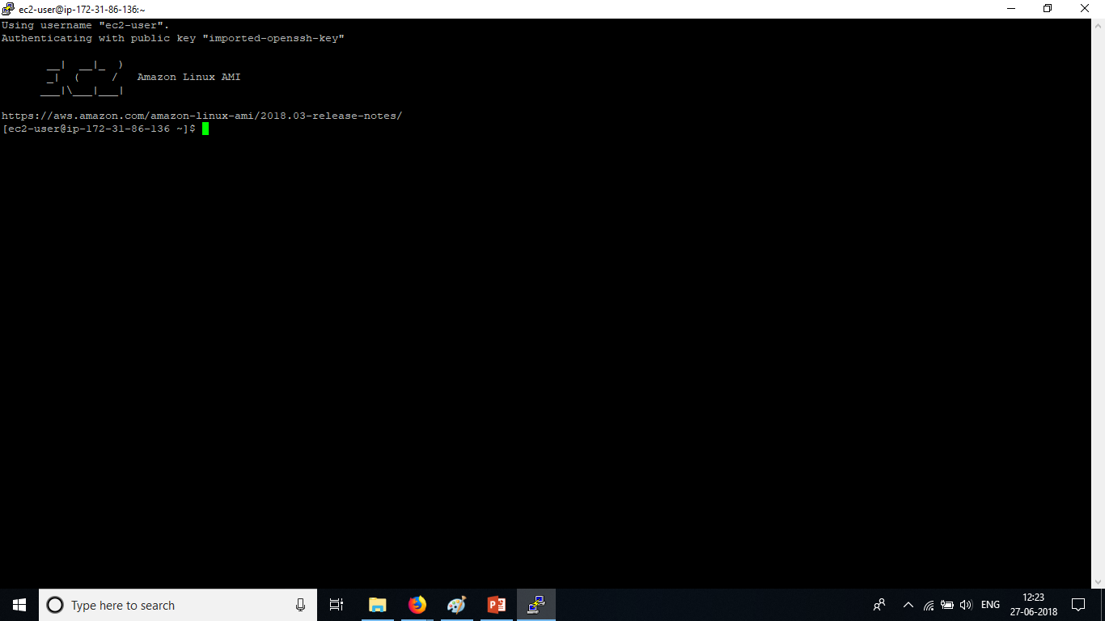
Creating a VM and SSH
In the instance configuration details, the user had mentioned certain commands in the Advanced Details as bash scripts. Those commands would have been already executed when the VM was launched and in the running state.

Slide 29
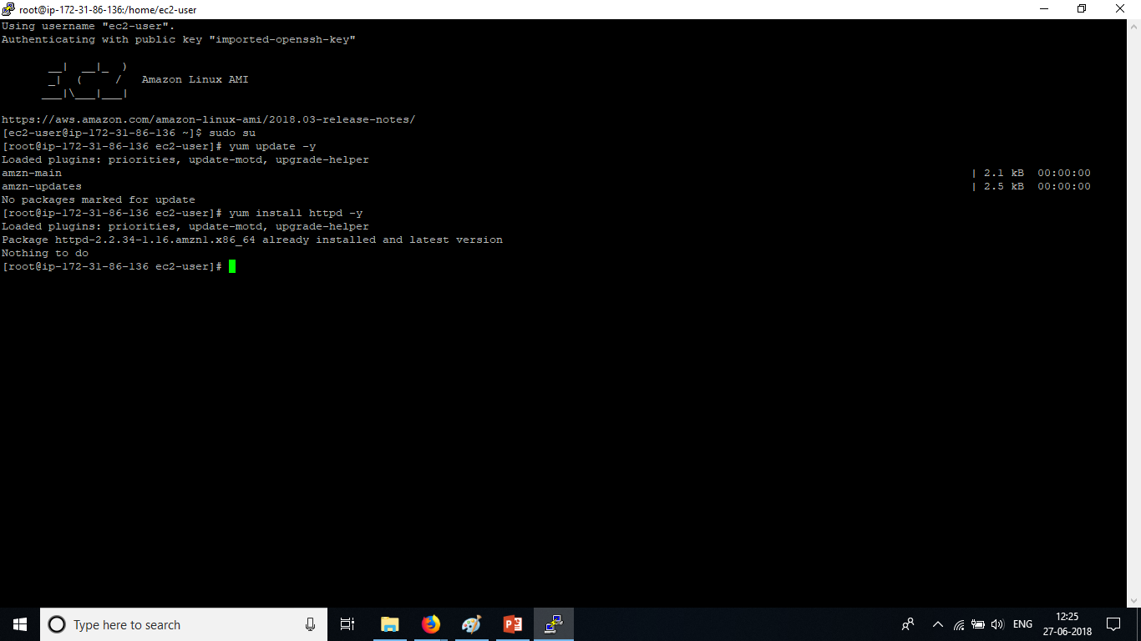
Creating a VM and SSH
The same commands when executed in the putty console gives “No packages marked for update” only because the commands were already executed when the bash script ran when the instance was launched.

Slide 30
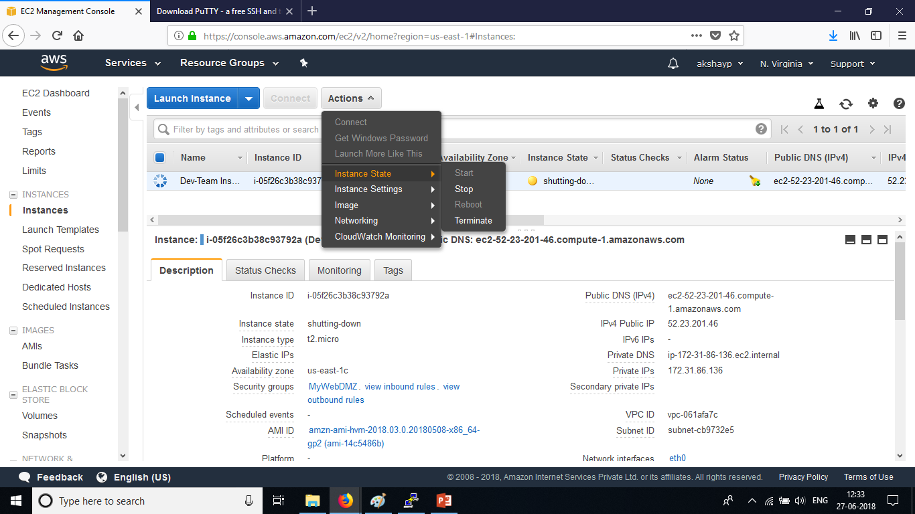
Creating a VM and SSH
To terminate, restart or stop an EC2 Instance/VM. Click on the instance. Click on Actions. Click on Instance state. Click on Terminate. If termination protection is enabled, disable it and then terminate the instance.

Slide 31
Creating a VM and SSH
Congratulations, We have together successfully started a VM in the cloud and SSHed into its operating system.
Homework : Try launching a VM with an IAM role to copy all the contents of a bucket with front end website coding to run on the VM.
Answer :
Attach IAM role – Create the role for EC2 service – Attach AWSS3FullAccess to the EC2 service role.
Launch a VM and add the IAM role in the EC2 instance configuration page.
Write down the following commands in the Advanced Details tab
#!/bin/bash
sudo su : To elevate privileges to super user
yum update –y : To install all the packages
yum install httpd –y : To install apache web server
cd /var/www/html/ : To navigate to the html directory to copy front end code
aws s3 cp - - recursive s3://<bucketname> /var/www/html/ : Copying the code from S3 bucket
service httpd start : Starting the web server
Allow HTTP and HTTPS through the security group configuration from anywhere or from My IP alone.

